Slide 1

Patient
Tracker

Slide 2

WARDIERE MEDICAL
About Patient Tracker
At Patient Tracker, our mission is to provide a seamless experience for healthcare professionals and patients alike, ensuring efficient management of medical records and facilitating access to life-saving blood supplies.

Slide 3
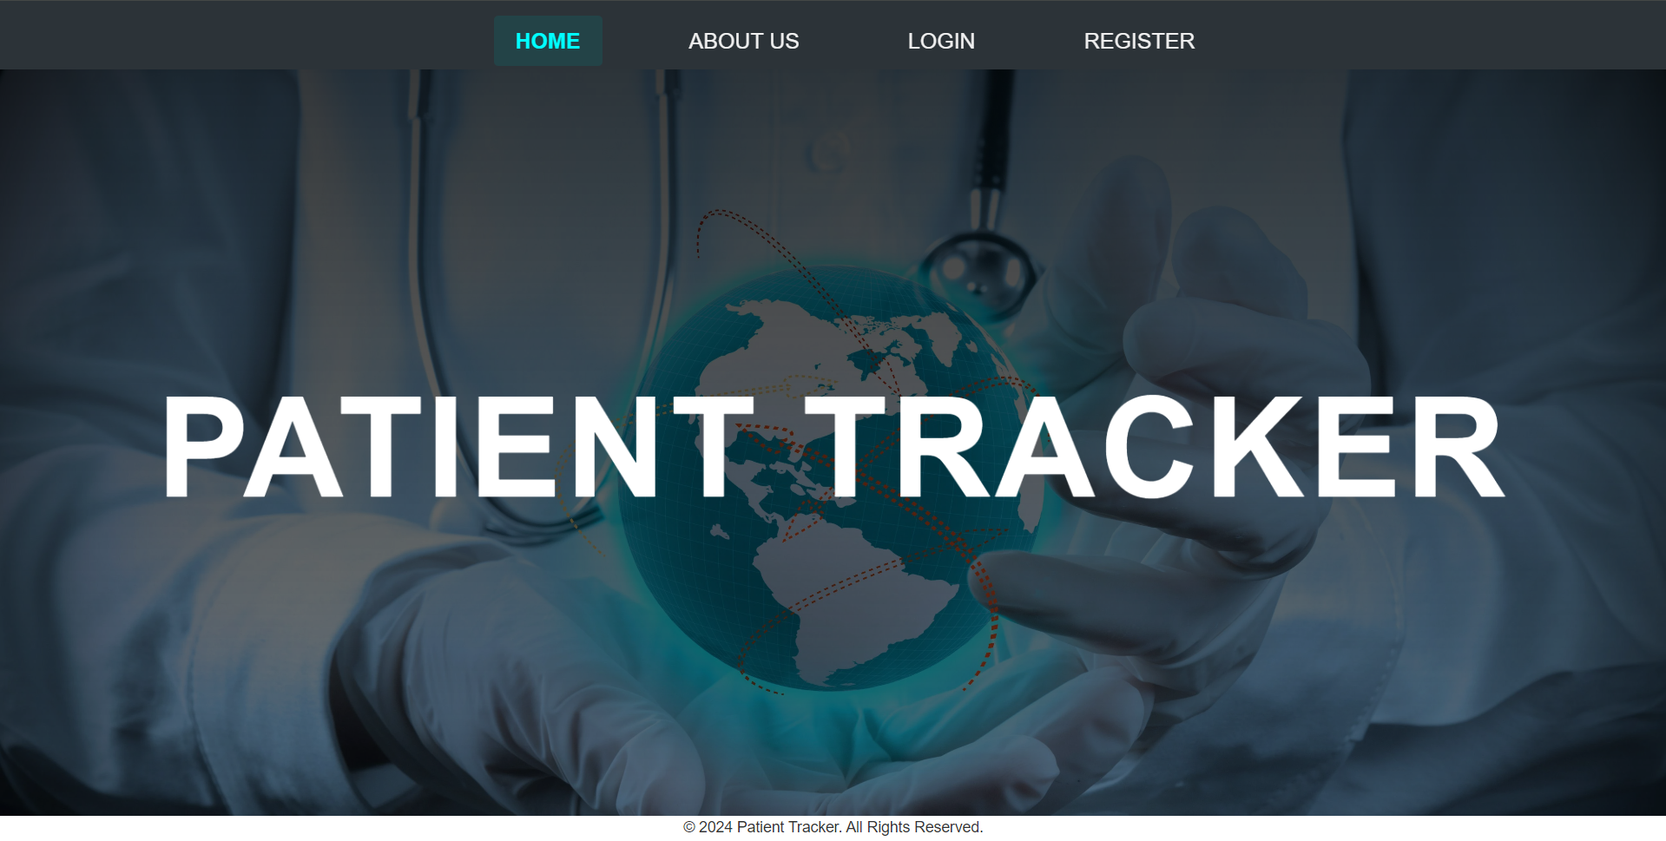
Home Page :

Slide 4
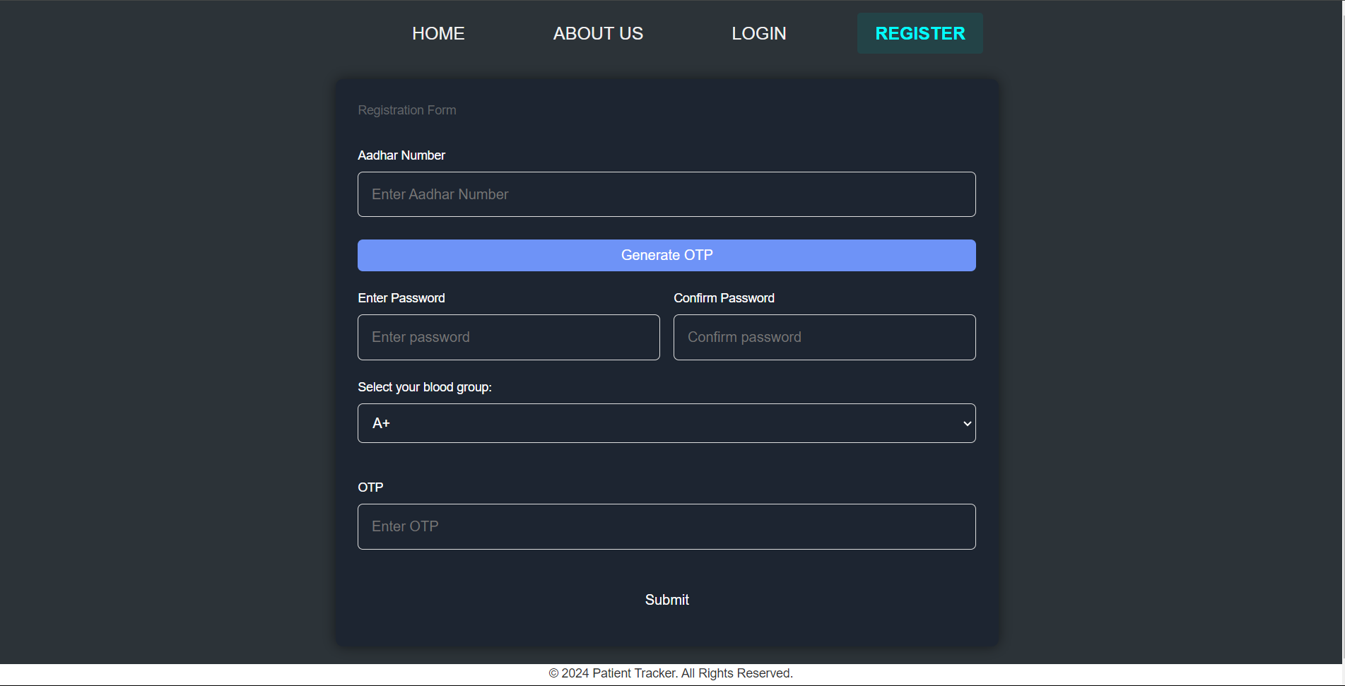
Registration Page :

Slide 5
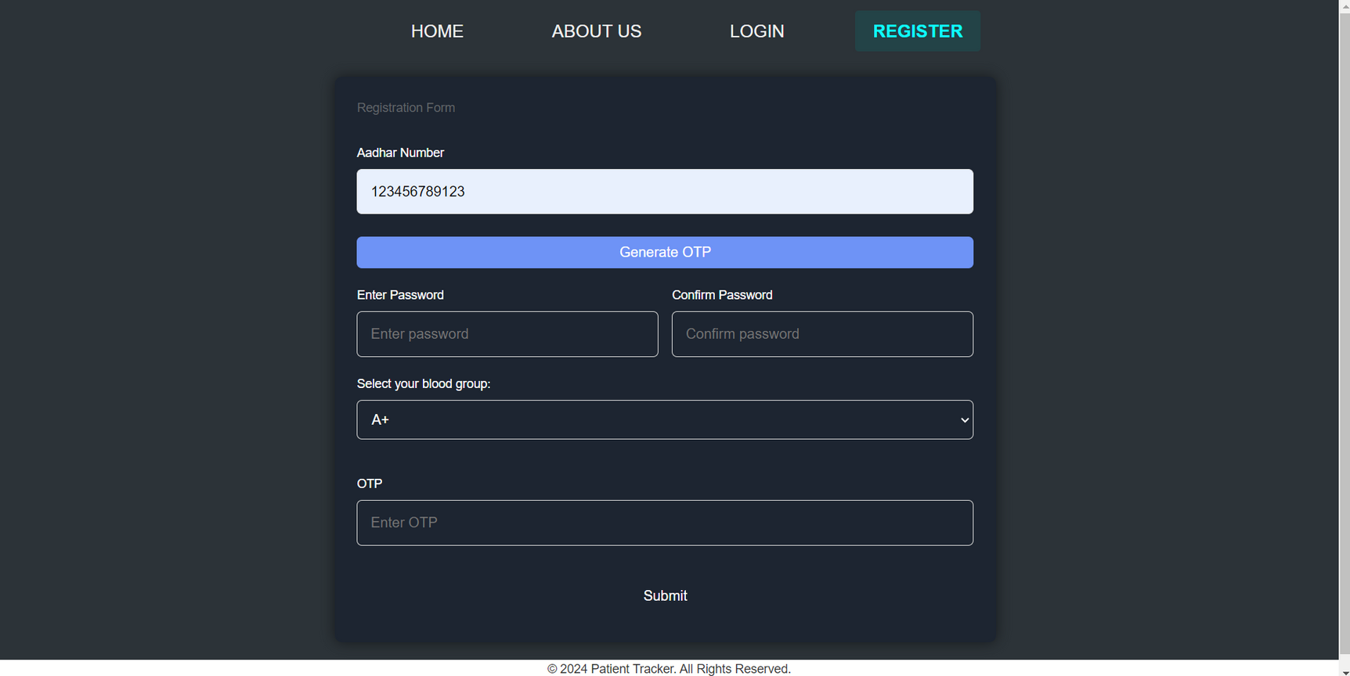
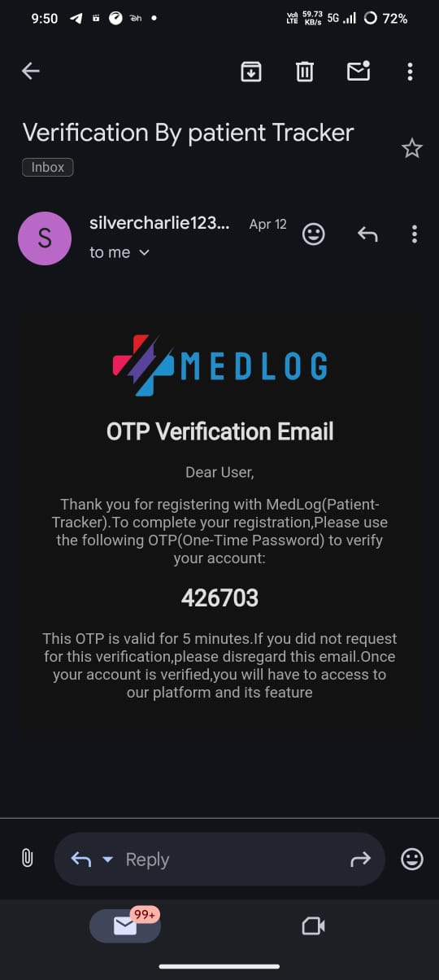

Registration Process :
Enter your 12-digit Aadhaar number in the specified field. Double-check to ensure the number is correct.
Click on the option to generate an OTP (One-Time Password). This OTP will be sent to the email id registered with your Aadhaar card.
Enter the OTP received on your email id in the provided field.
OTP receive by User

Slide 6

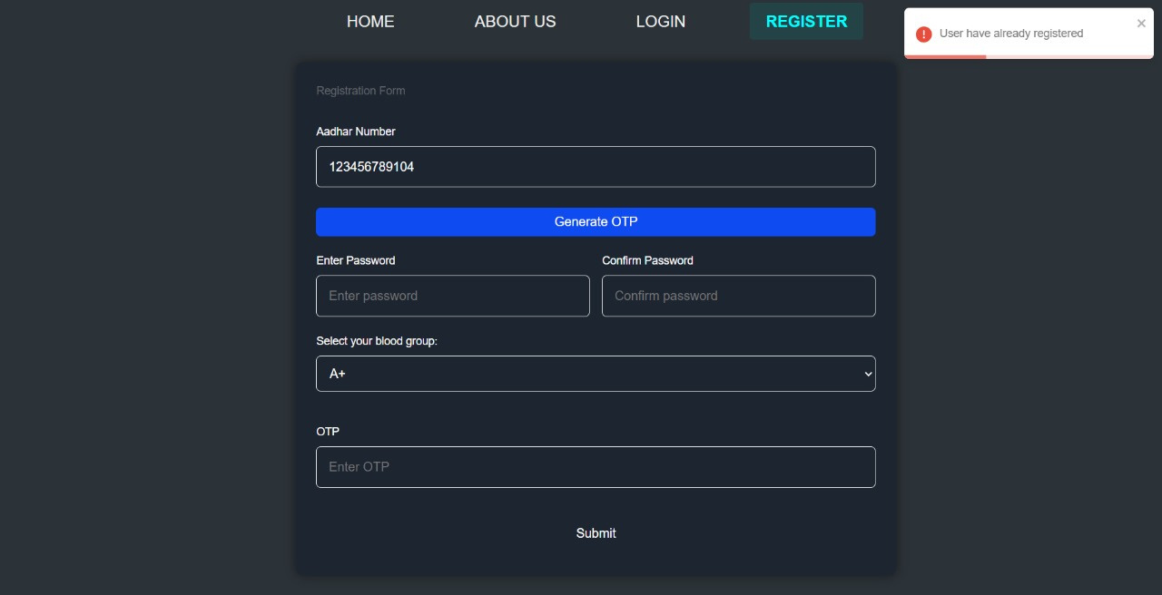
Registration Process :
1) System checks if the Aadhaar number is already registered.
2) If the Aadhaar number is already registered:
Display a message: “User have already registered”.
User have already registered

Slide 7

Registration Process :
1) Ensure the Aadhar number entered is exactly 12 digits long.
2) Ensure the Aadhar number is already in our database
if this condiiton not met then user shows message “Invalid Aadhar Number”
Invalid Aadhar Number

Slide 8
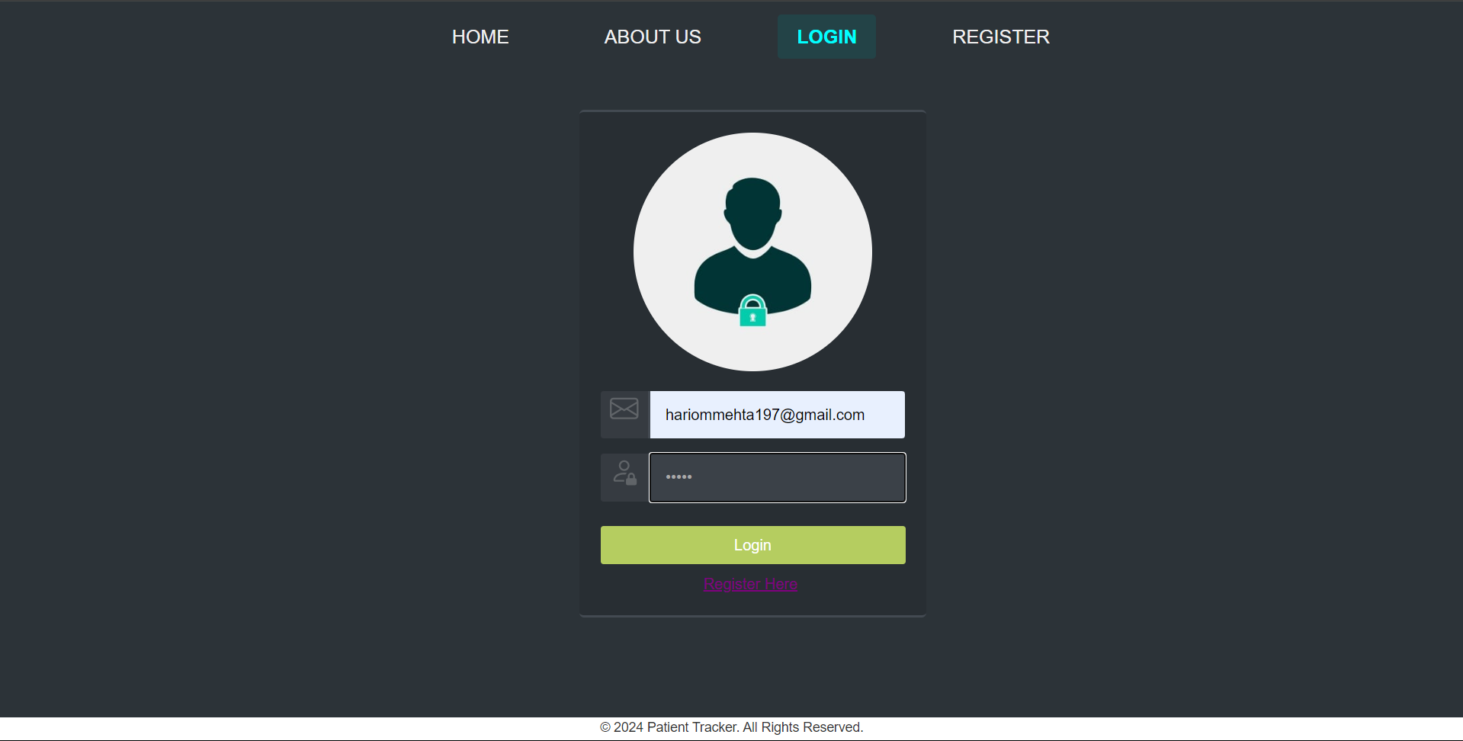
Login Page :
After registration user can login throw email address in the provided email field and Enter password in the password field.

Slide 9
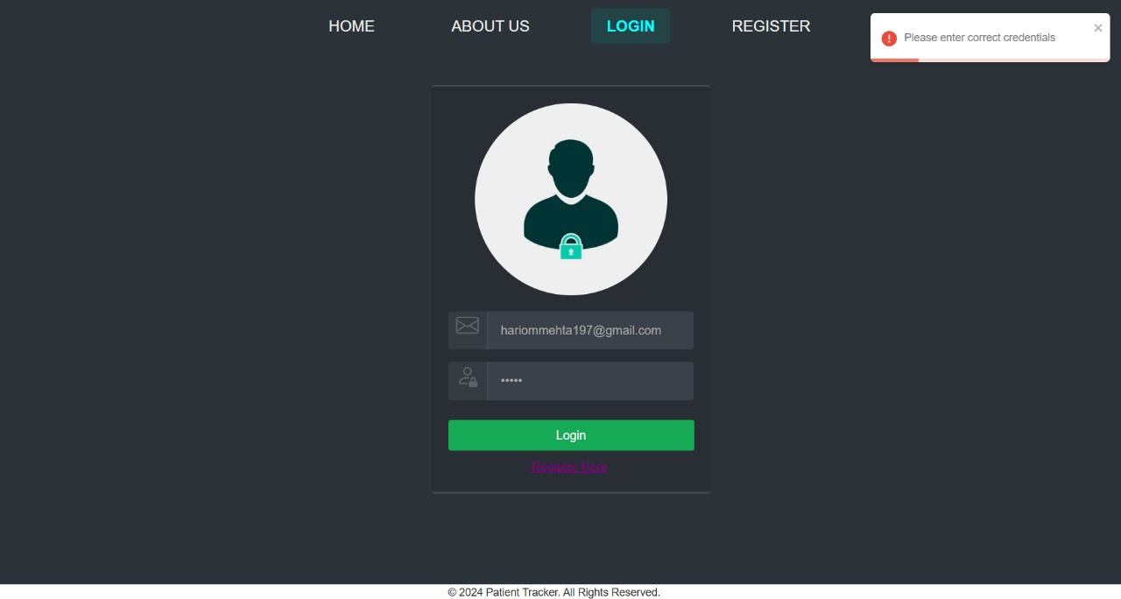
Login Page :
If User enter wrong password or wrong email then shows pop-up “Please enter valid credentials”.
Please enter correct credentials

Slide 10
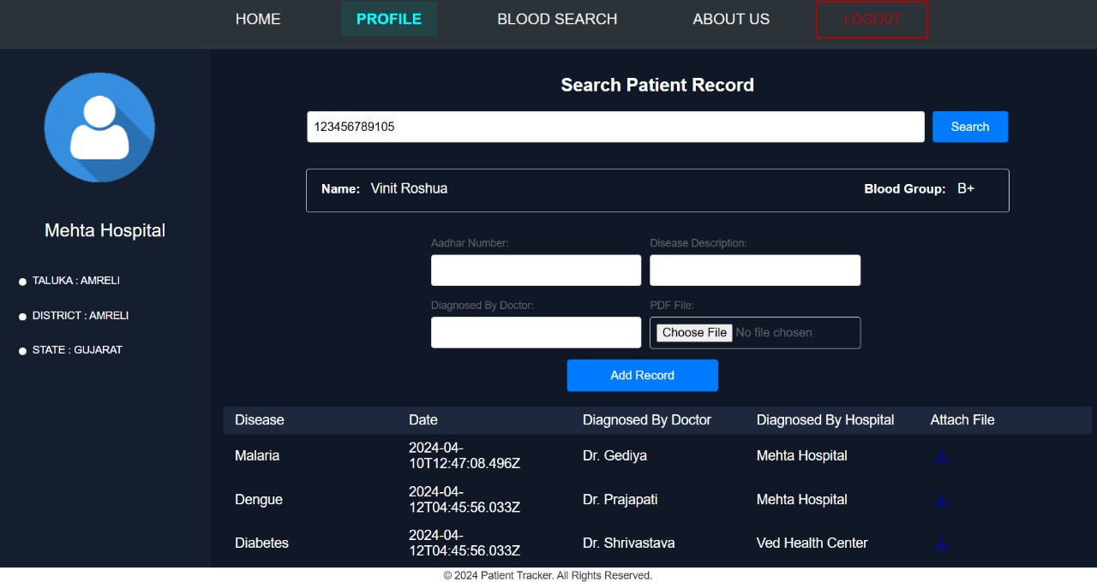

Hospital Page :
1) Hospital can Search Patient Record by entering the Aadhar Number.
Search patient history
by Aadhar number

Slide 11
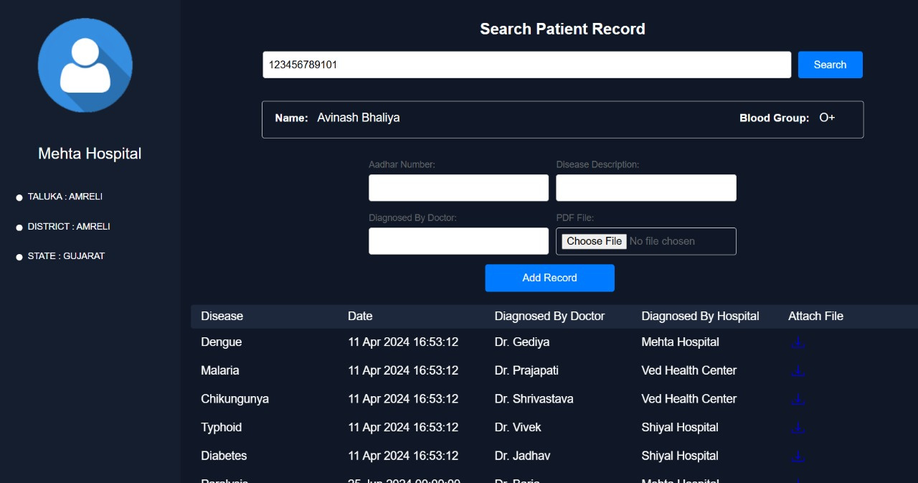


Hospital Page:
1) Hospital can add Record of the patient like Disease name , date of the treatment ,
Diagnosed By Doctor, Diagnosed By Hospital and also attached the file
Add Record
1) Disease name
2) Diagnosed By Doctor
3) Aadhar Number
4) Attached the file

Slide 12
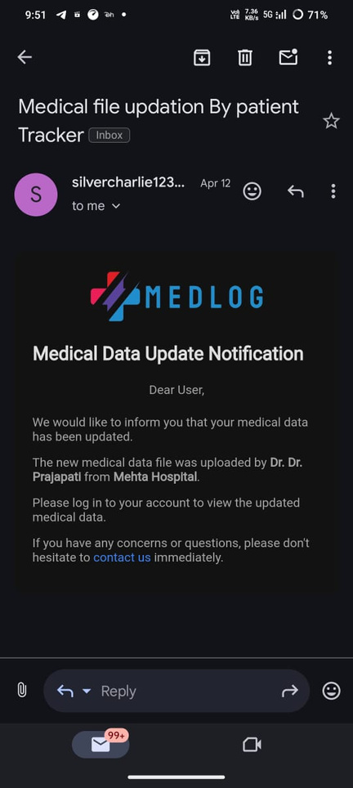

Add Patient Record :
1) When Hospital update the patient record Patient received an Email.
Email contain doctor name and hospital name
Patient Record Updated Email receive by Patient

Slide 13
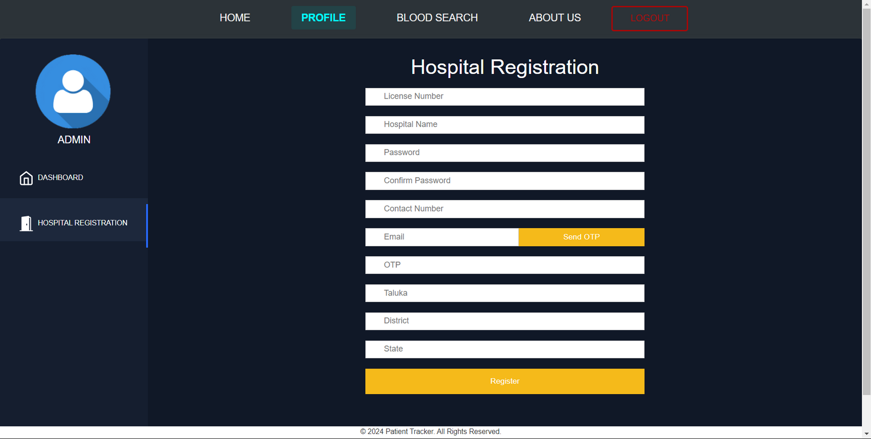
Admin Dashboard :
Admin can register a hospital which have a license number and government approved.
After hospital registration hospitals get their username and password

Slide 14
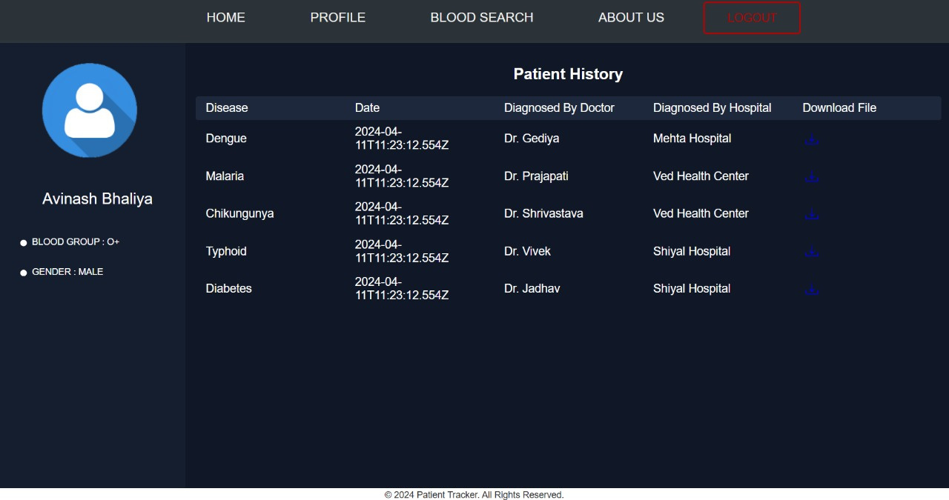


Patient Dashboard :
1) Patient only see their medical record and also download attached file
Patient download file of the
medical record
Patient only read data they
cannot update the data

Slide 15
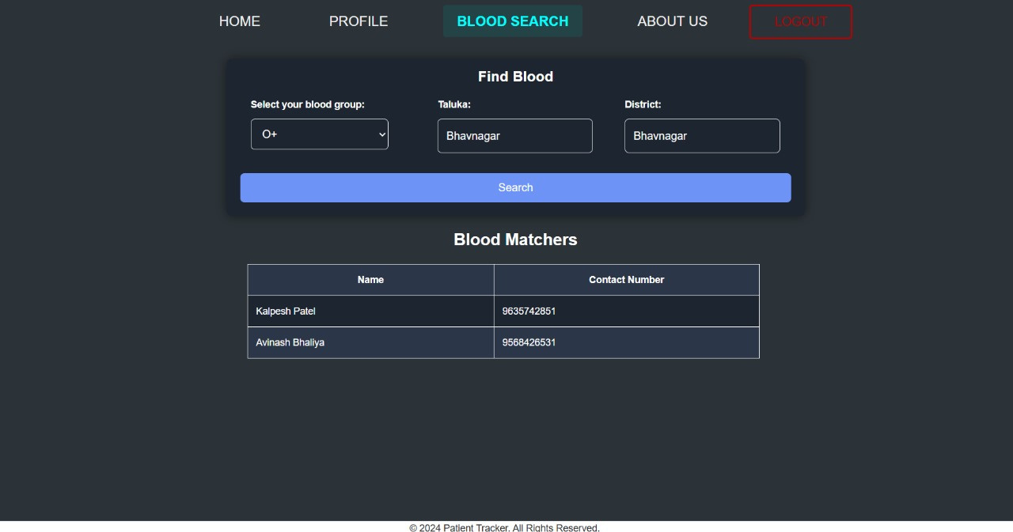

Blood Search Dashboard :
1) Every user of the patient tracker can search for nearby blood banks or donors by entering their Taluka and District.
2) Users can search for any blood group nearby and also obtain the name and mobile number of donors.
Blood Search Using
1) Blood Group
2) Taluka
3) District
name and mobile number of available donors

Slide 16

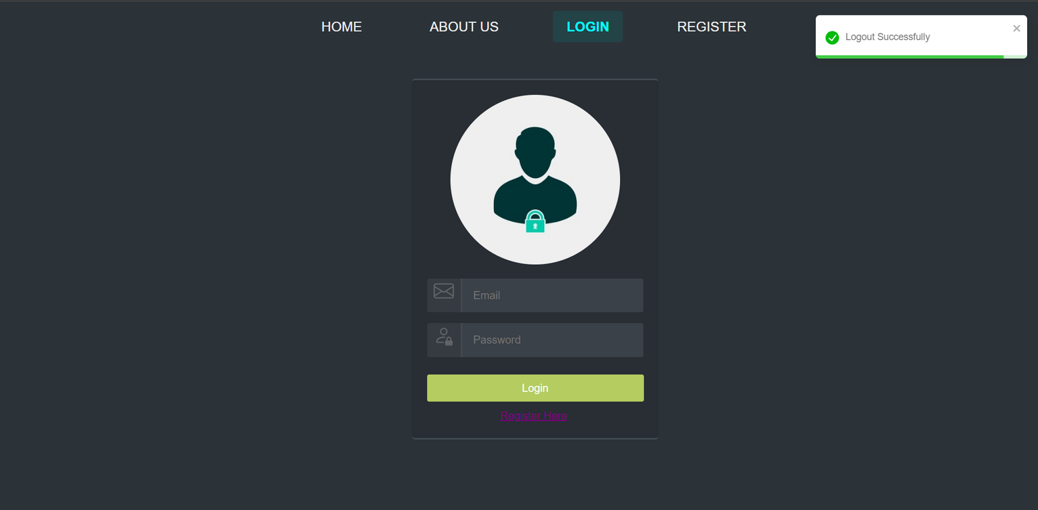
After clicking on LOGOUT button user
will be redirected to the login page

Slide 17


